Slide 1

Department of Information Technology
NBA Accredited A.P. Shah Institute of Technology, G.B.Road, Kasarvadavli, Thane(W), Mumbai-400615 UNIVERSITY OF MUMBAI Academic Year 2021-2022

Slide 2
A Project Report on Real-Time Object Detection Submitted in partial fulfillment of the degree of Bachelor of Engineering(Sem-6)
in INFORMATION TECHNOLOGY
By Snehal Shanbhag - 19104008 Pranjali Shimpi - 19104017 Akansha Rawat - 19104007 Under the Guidance of Prof. Sonal Jain
Prof. Charul Singh
Pr

Slide 3
1.Project Conception and Initiation

Slide 4
Object detection is a technology that detects the semantic objects of a class in digital images and videos. One of its real-time applications is self -driving cars.
In this, our task is to detect multiple objects from an image. The most common object to detect in this application is the car, motorcycle, and pedestrian and other objects in a roadway.
For locating the objects in the image we use Object Localization and have to locate more than one object in real-time systems.

Slide 5
There are various techniques for object detection, they can be split up into two categories, first is the algorithms based on Classifications. CNN and RNN come under this category.
The second category is the algorithms based on Regressions. The YOLO method comes under this category.
The YOLO algorithm is fast as compared to other classification algorithms.

Slide 6
1.1 Objectives
To identify and locate one or more effective targets from still image or video data. It comprehensively includes a variety of important techniques, such as image processing, pattern recognition, artificial intelligence and machine learning.
To automate the recognition and extraction process.
To detect the object segment from the video frame.
To classify the features in order to recognize the objects detected.

Slide 7
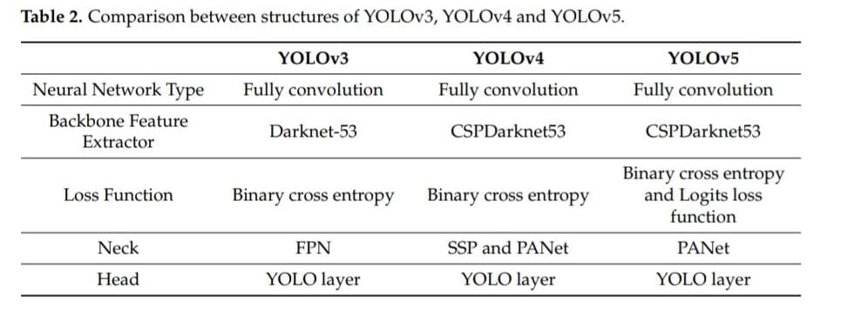
1.2 Literature Review

Slide 8
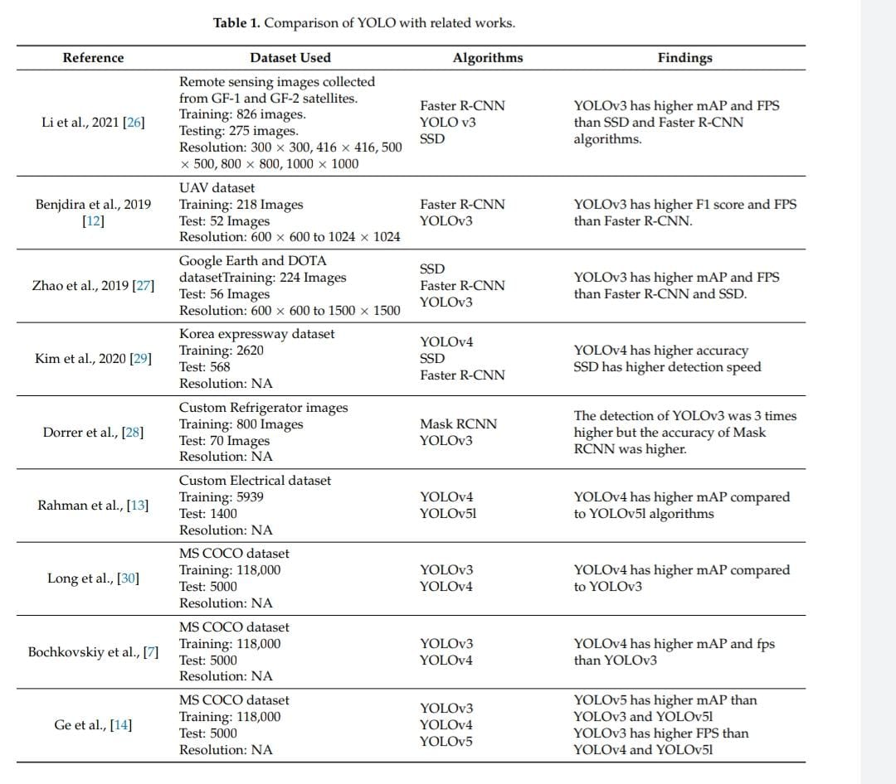

Slide 9
1.3 Problem Definition
To make a ML project on Real Time Object Detection with the best algorithm such that the project focuses on accuracy of the output, detection of 10 classes or as much as we can.

Slide 10
1.4 Scope
Our topic mainly focuses on Real Time Object Detection related to Road:
Detection of pedestrians
Detection of vehicles
Detection of other roadway objects i.e. traffic signs and lights, etc.

Slide 11
1.5 Technology stack
Software requirements:
Frontend-Flask, HTML, CSS
Backend - Python
OpenCV library
Yolo v5 algorithm
Open-source dataset
Hardware requirements:
GPU
Nvidia driver
RAM - 8GB or more

Slide 12
2. Project Design

Slide 13
2.1 Proposed System
The proposed method uses these Yolo v5 to develop a system model which consists of multilayers to classify the given objects into any of the defined classes.
The schemes then use multiple images and detect the objects from these images, labeling them with their respective class label.

Slide 14
2.1 Proposed System
Person
Pedestrians
Traffic sign
Traffic
Traffic light
Car
Class
Ambulance
Vehicles
Truck
Bus
Cat
Animals
Dog

Slide 15
2.2 Design (Flow Of Modules)
Flask run command will call app.py
App.py- It will initiate the process of frontend to take input from users
Detect.py- This file is responsible for detection of objects
Download.html and run/detect- This will create a download button on frontend for downloading the output file

Slide 16
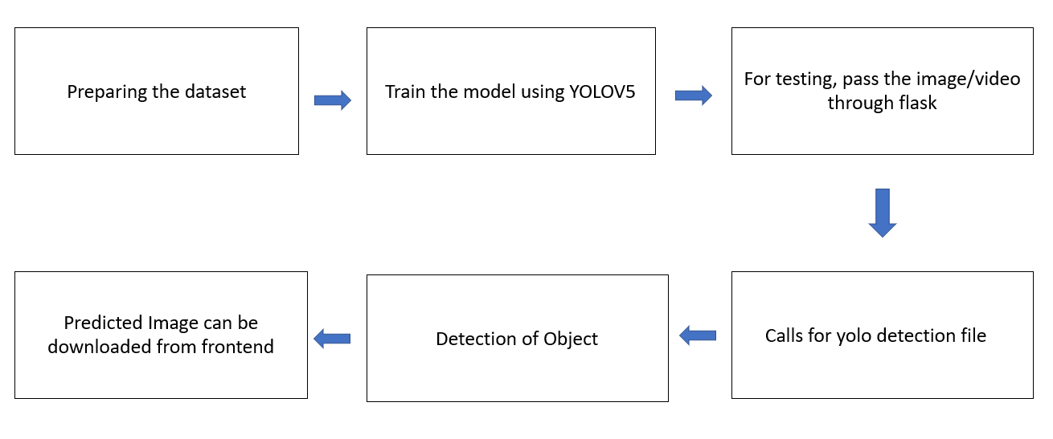
2.3 Block Diagram

Slide 17
3. Implementation

Slide 18
The outcome of object detection project is to recognize and locate all trained objects in a frame related to road.
Object detection is implemented in two ways:
Video streaming
Through images
User can upload image or video that is to be detected through the web application and get the desired output with certain accuracy

Slide 19
5. Result

Slide 20
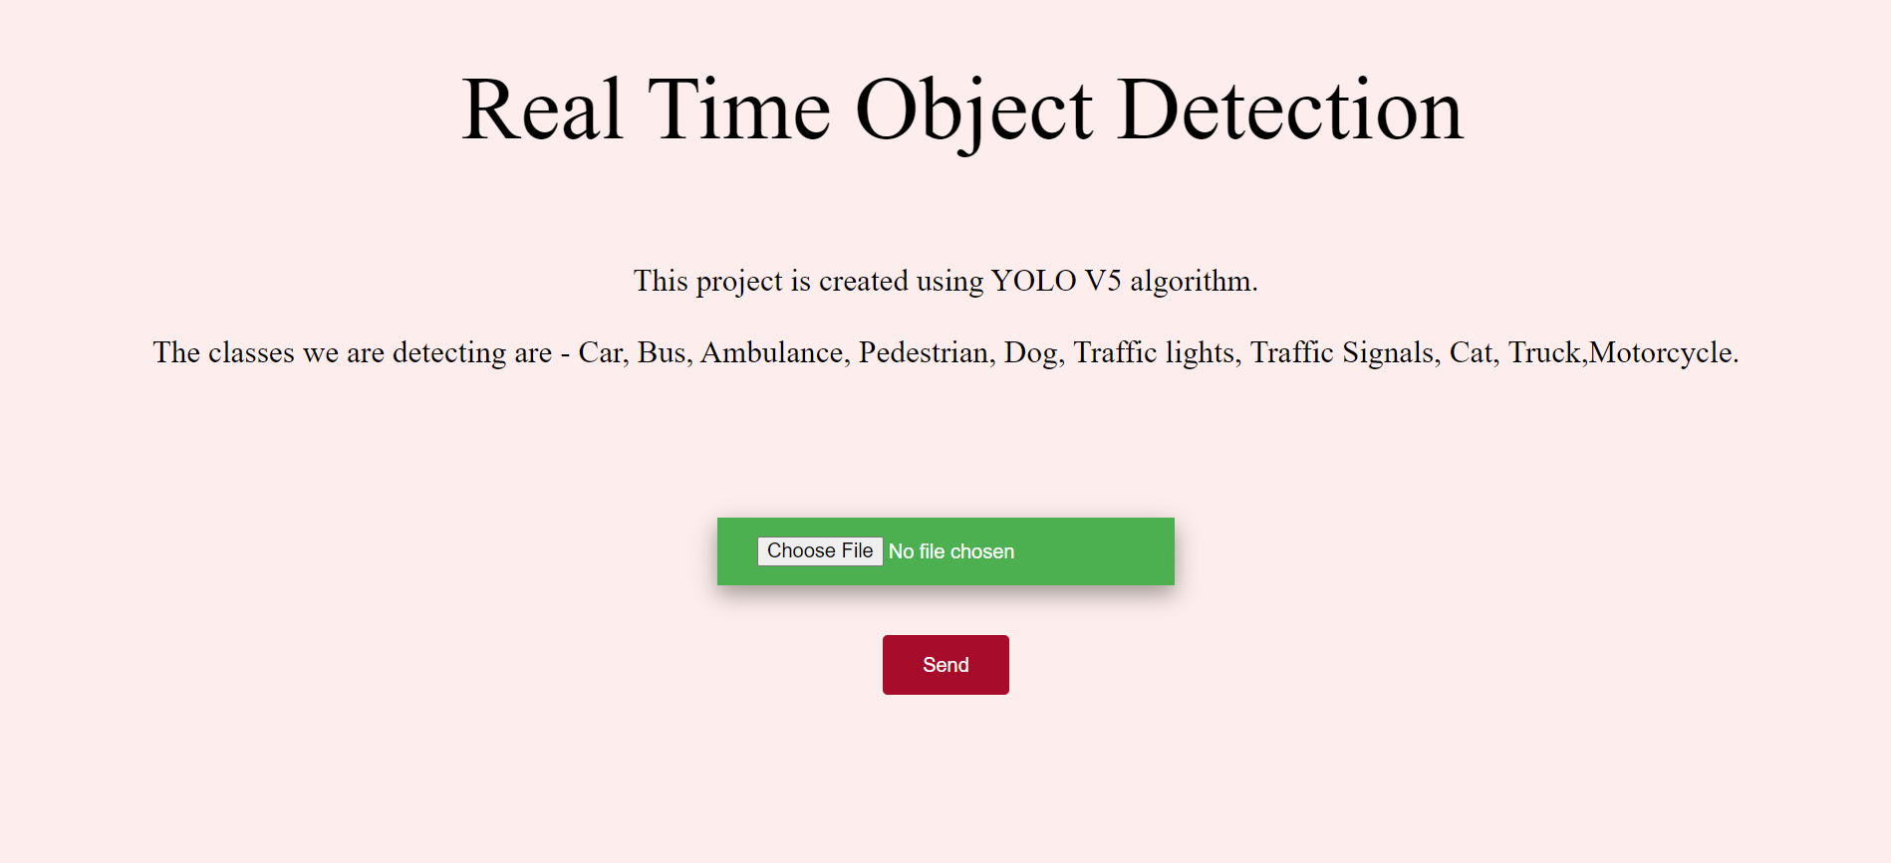
Frontend interface:

Slide 21
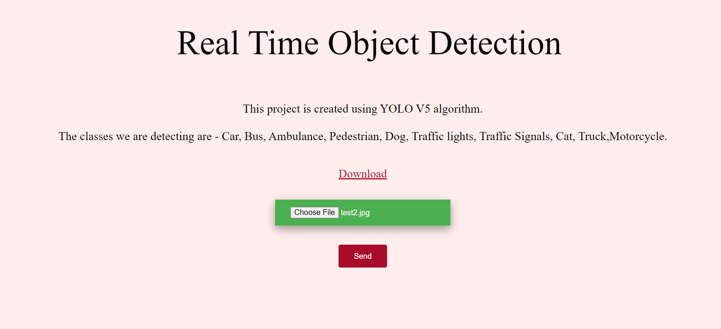
Output on frontend:

Slide 22
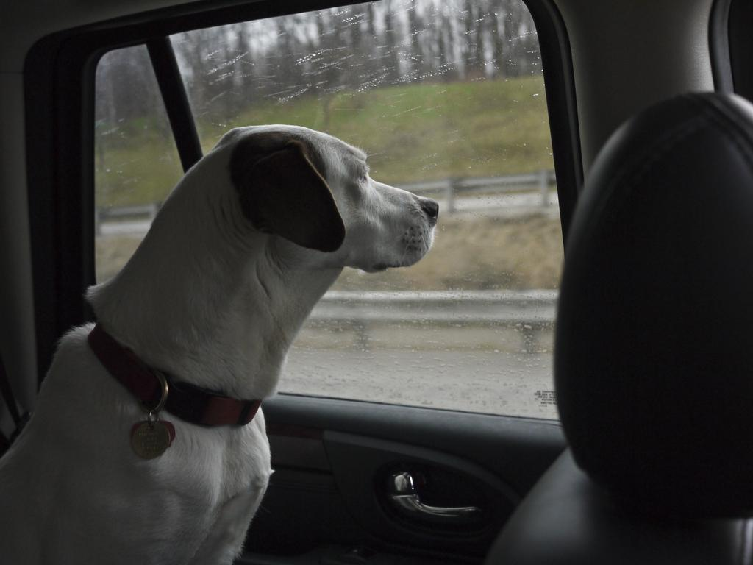
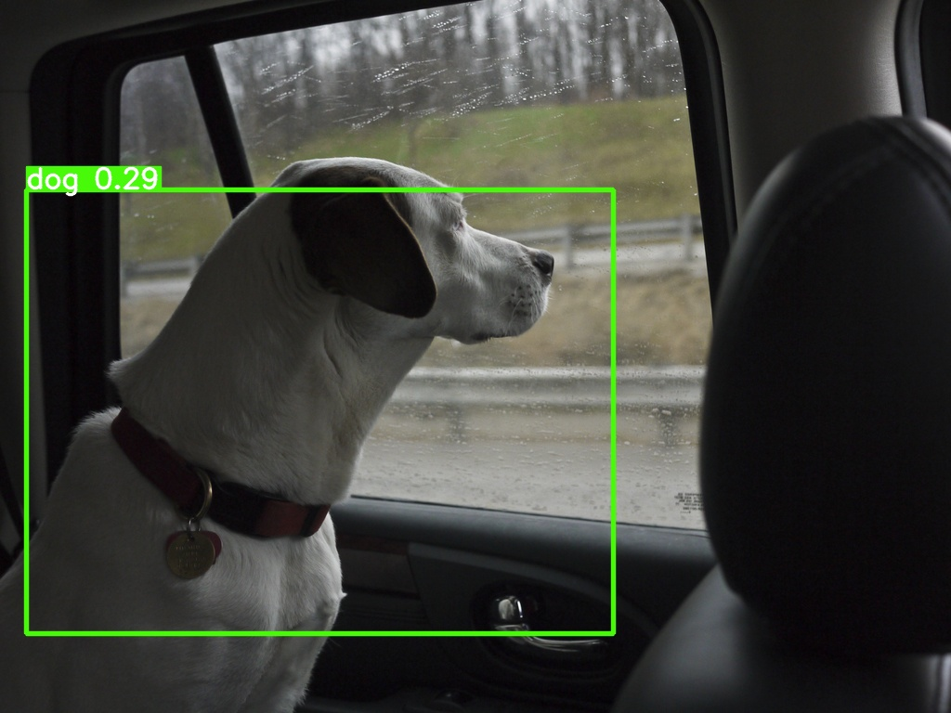

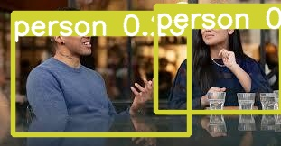

Slide 23
6. Conclusion and Future Scope

Slide 24
Conclusion
Being a unified object detection model that is simple to construct and train in correspondence with its simple loss-function, YOLO can train the entire model in parallel.
YOLO is also better at generalizing Object representation compared with other object detection models and can be recommended for real-time object detection.
Comparing Yolo v3, v5, and v5 version - Yolov5 turned out to be the best algorithm taking less time and giving max accuracy.

Slide 25
Future Scope
Can be used in :
Biometric recognition
Surveillance
Smart cars
Lane detection
Medical analysis

Slide 26
References
https://leadingindia.ai/internshipproject
https://opencv.org/multiple-object-tracking-in-realtime/
https://towardsdatascience.com/implementing-real-time-object-detection-system-using-pytorch-and-opencv-70bac41148f7
https://www.mdpi.com/1424-8220/22/2/464/pdf
https://www.researchgate.net/publication/351411017_Real-Time_Object_Detection_Using_YOLO_A_Review

Slide 27
Thank You

